Slide 1
CHAPTER 2 MOULD MATERIAL- its properties, varieties, other ingredients, testing PATTERN- different allowances, types of pattern CORE- its material and properties, types of core, core making CORE PRINT- area calculation CHAPLETS-

Slide 2
Mould-block of mass of refractory material or metal in which a mould cavity is made. Mould material- sand/ceramic/plaster of Paris, die of CI/ bronze, steel, alloy or refractory material Sand properties- a) refractoriness-ability to withstand high temperature without fusing. It depends on amount of silica. b) permeability- ability to escape air/gas/moisture present/ developed in mould. c) green strength -strength at moist condition. It ensures making and handling of mould. Compressive green strength- 30-160 kpa, green shear strebgth 10-50kpa. Adhesiveness- sand clings well to mould box cohesiveness-mould should not collapse/ break during withdrawal of pattern d) dry strength- strength at dry state, prevent mould erosion and enlargement of mould due to metallostatic pressure. Value 140-1800 kpa. e) Flowability- property to flow like fluid all around. Helps to distribute ramming pressure. ( + when – green strength, + moisture content, - grain size) f) collapsibility- ease of collapsing, ability of sand to allow free contraction of metal during solidification so as to prevent cracking/tearing. Ease of breaking the mould.

Slide 3
Types based on composition- 1) silica sand- SiO2 is prime composition. Oxides of sodium, potassium, magnesium and calcium are also present as impurities. Impurities should be kept within 2% for better result. Fusion point 1450-1500 2) Chromite sand- Cr2O3-44%, Fe2O3-28%, sIo2-10%, Al2O3+MgO+CaO<20% fusion point 1800 Deg. Cent, small amount of binder needed, heavy steel casting with good finish. 3) zircon sand- zirconium oxide is prime constituent. ZrO2-66%, sIo2-31%, Al2O3-2%, Fe2O3-.75% Higher fusion point 2400 degree centigrade, high thermal conductivity, low thermal expansion, small amount of binder needed. Costly item. Applied for precession steel casting with better finish. Types based on use/nature- 1) green sand – 30% clay, 8-18% water. Used for rough and simple casting. 2) dry sand- moisture removed, provide strength, thermal stability, used for large and heavy castimg 3)loam sand- 50%sand+50% clay, water is added, used for large and heavy casting 4)facing sand- it is directly applied next to pattern in mould cavity, therefore it comes contact with molten metal . So it should have high refractoriness and must be of fine size to ensure better finish. 5) parting sand- dry sand without binder. After removal of pattern, parting sand is sprinkled on the mold so that mold does not stick. 6) floor sand/ backing sand- it is used to back up face sand of large and heavy mould. Sand is black in colour as it is mixture of burnt sand and clay with binder. 7) core sand- sand used to make core. higher refractoriness, higher collapsibility, etc. are essential requirements. The properties are obtained by using organic binders like- lineseed oil, core oil, fish oil, dextrin, molasses etc. the use of organic binder develop strength by polymerization and cross linking as it is baked at 175 deg cent.

Slide 4
Binder- function is to hold sand particles for developing strength to retain shape and other working loads. Clay is normal binder. The clay's particles carry a negative electric charge and therefore, . Heavy metals, and free radicals are said to carry a positive charge.Clay minerals have the ability to attract water, water do not go inside clay particles but lie outside on surface like adsorption. Other binders- i) montmorillonite- basically Na/Ca bentonite, weathered product of volcanic ashes, melting temp-1250-1300 deg. Cent., Na bentonite- high dry strength, low green strength, High resistance to burn out, better tolerance of variation in water content. Used for large casting ii) kaolinite- residue of weathered granite/basalt. Melting temp- 1780-1790 deg. Cent. It adsorbs fewer ions that clay as it is electrically more balanced. Iii) illite- Binding action is due to- i) electrostatic bonding (ii) surface tension force (iii) inter particle friction water- Water is essential for binding action. The % depends on type of binder, sand grain composition, grain size and shapes. However, 5% water is sufficient for binding. Some extra % around 3-5% is added to increase plasticity but more reduces strength and formability.
Some other binders- i)cereal binder- increase strength and collapsibility (ii) Saw dust- improve collapsibility, increase porosity and flowability (iii) coke/pitch- increase hot strength (iv) graphite- for better finish (v) molasses- increase dry strength and edge hardness

Slide 5
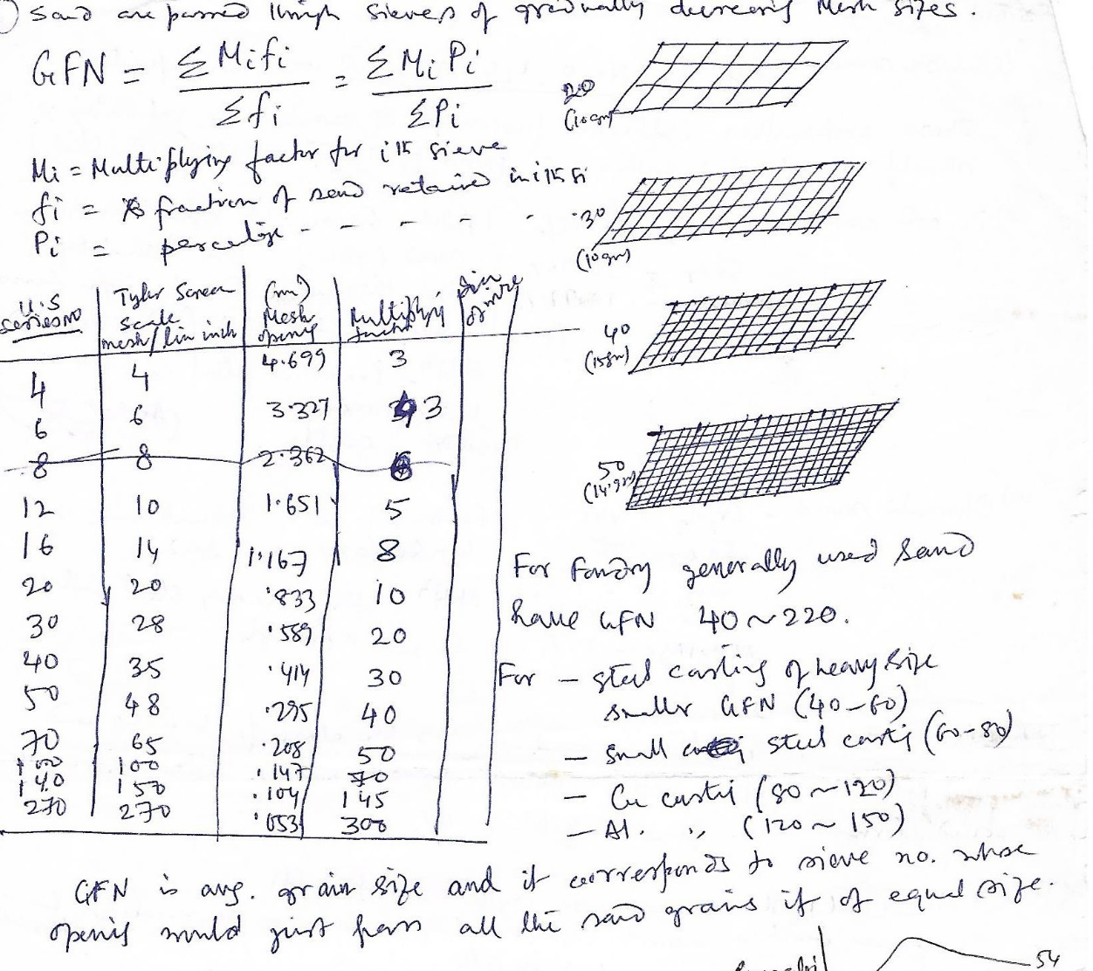
Testing
Moisture content test- i) weight difference method- heat at 105-140 deg cent for 2 hrs.
ii) Moisture teller- dry the sand with hot air flow and calculate by wt. diff. method.
iii) Rapid moisture teller- mix sand with CaC2 to remove water to form C2H2. amount of C2H2 is proportional to pressure . Calibration of pr. Gauge is needed to give moisture content.
Grain size- identified by grain fineness number GFN.
Permeability- defined by permeability number (P). It is expressed as the volume of air in cubic centimetres that will pass per minute under a pressure of 10 kg/m² through a specimen of sand 1 square centimetre of cross-sectional area and one centimetre in height.
P=VH/pAT = 50.128/T for standard case---V=vol. of air 2000cm3, H=5.08cm, p air pr= 10gm/cm2, A= Area=20.268 cm2, T= Time in min.
Problem-calculate permeability no. of a sand std specimen if it takes 1min.15 sec to pass 2000cm3 air at pr. 6gm/cm2

Slide 6
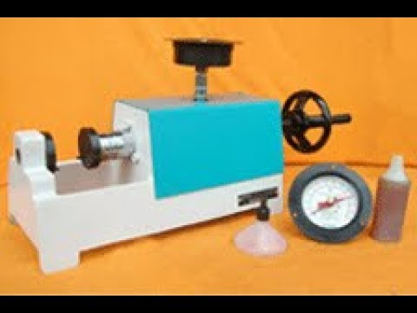
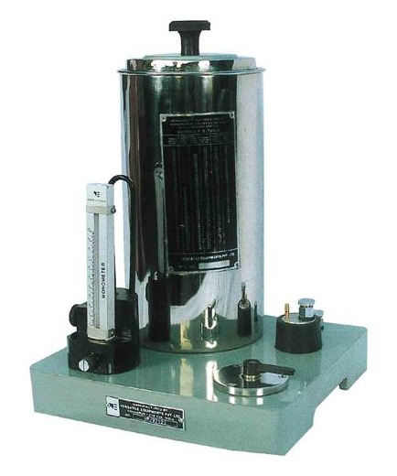
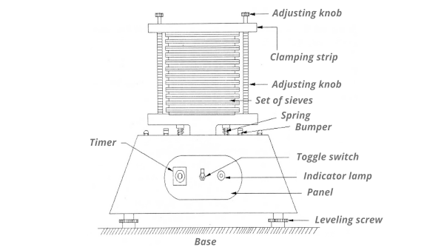

Slide 7
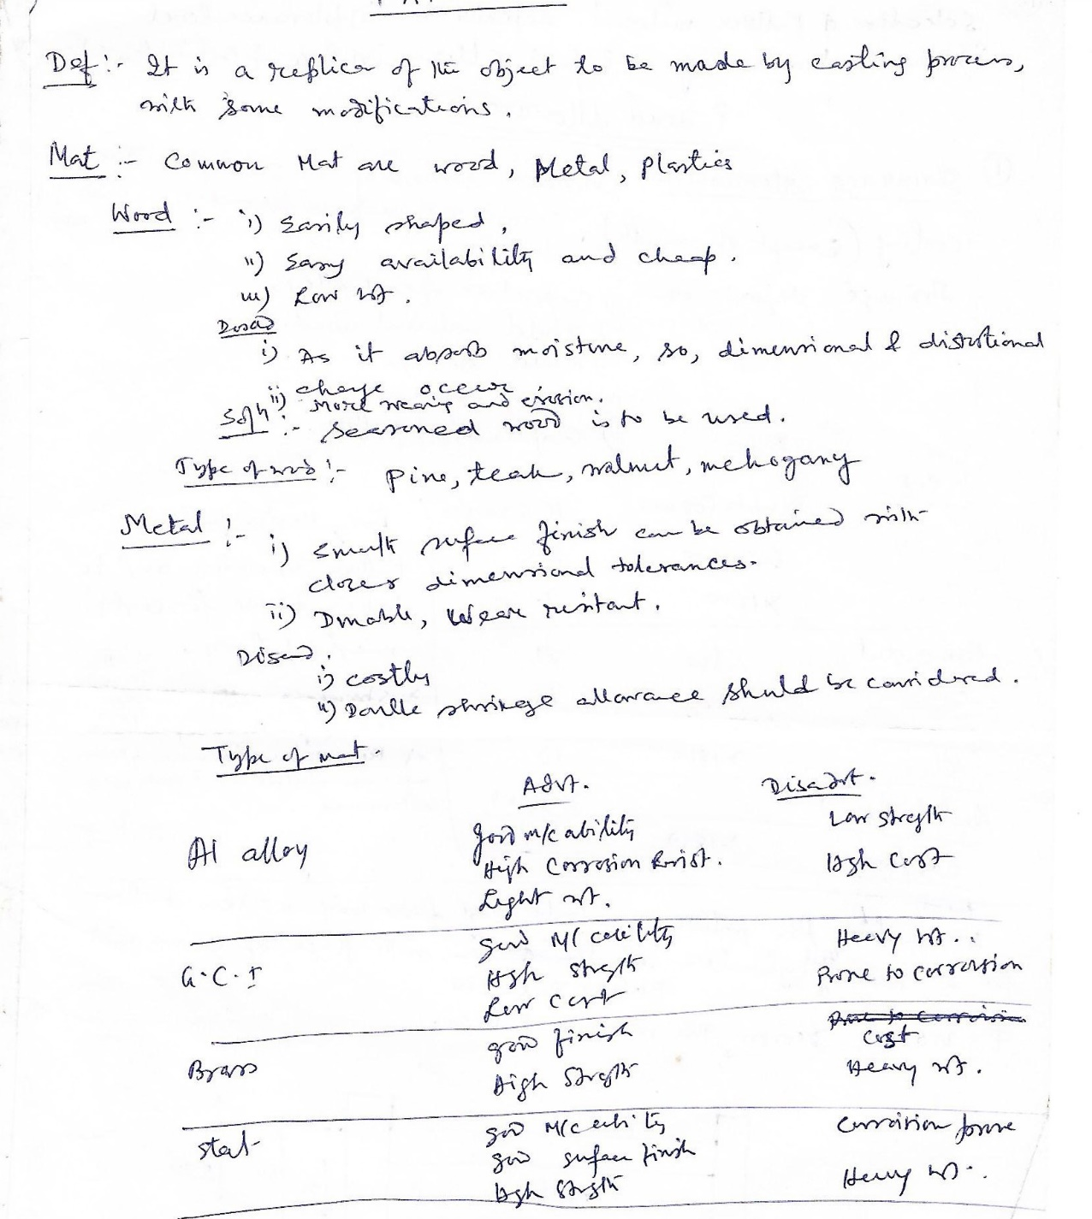
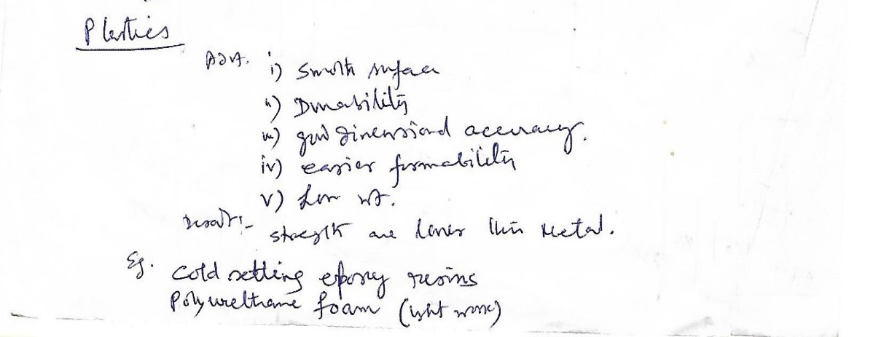
PATTERN

Slide 8
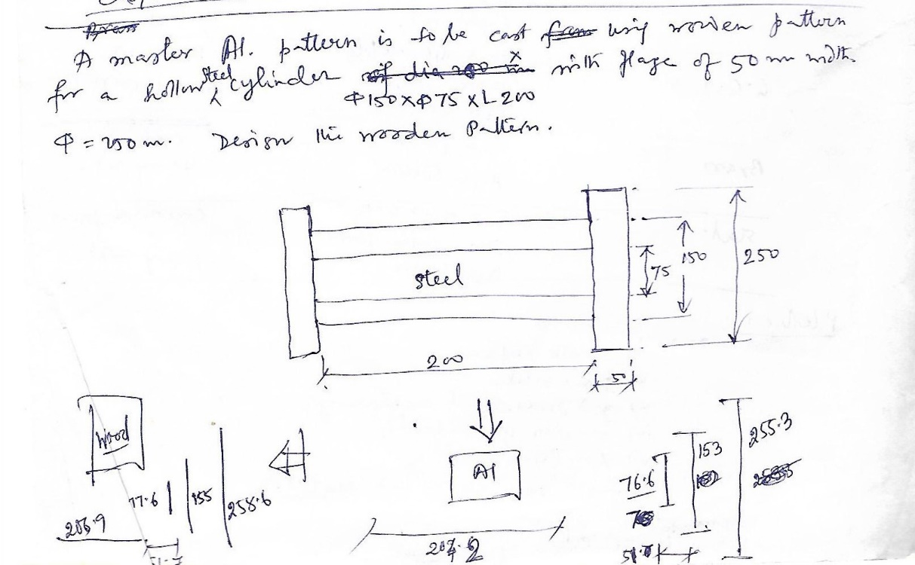
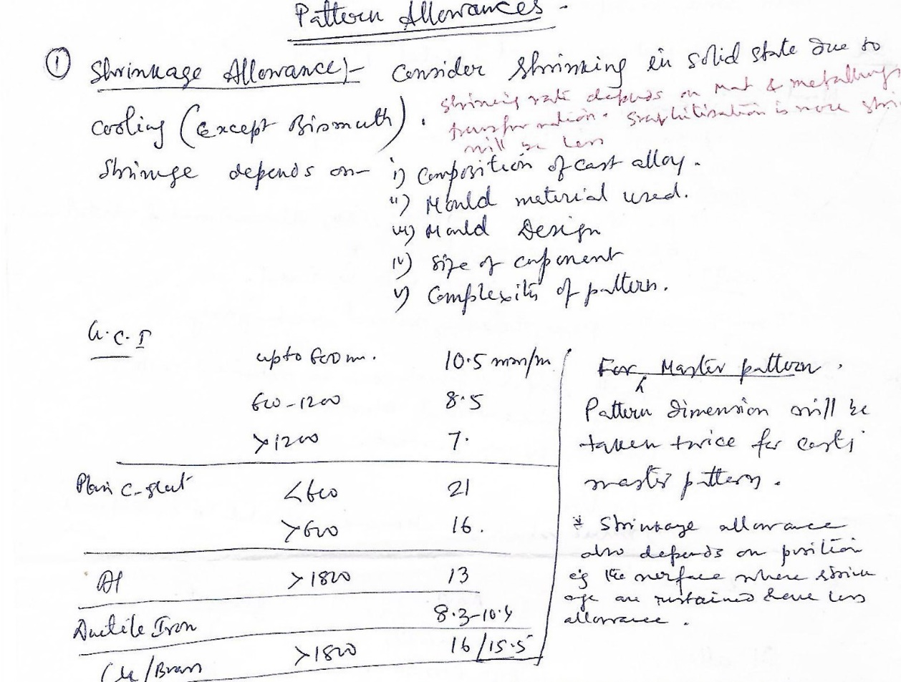
PATTERN ALLOWANCES
The shrinkage allowance depends on the coefficient of thermal expansion of the material (α). A simple relation indicates that higher the value of α, more is the shrinkage allowance.
3.For a dimension ‘l’, shrinkage allowance is αl (θf –θ0). Here θf is the freezing temperature and θ0 is the room temperature.

Slide 10
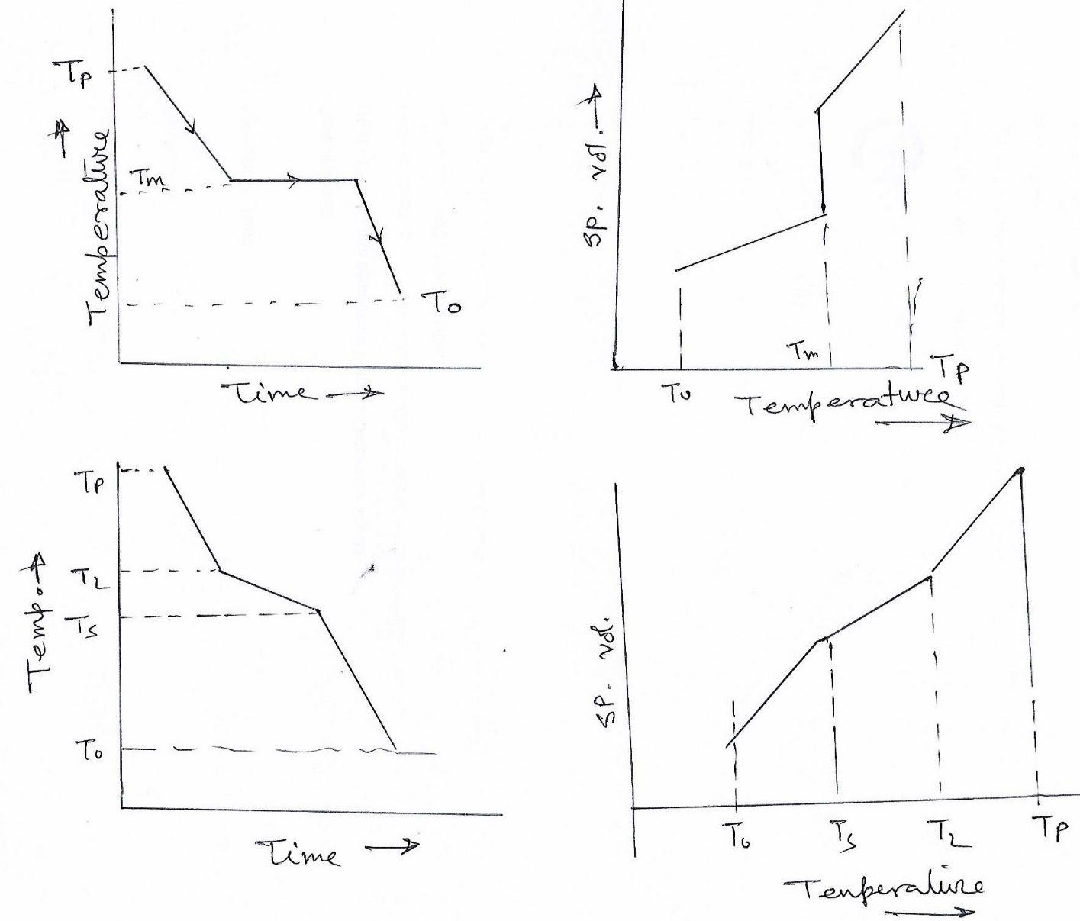
Most metals shrink when cooled from liquid state-liquid shrinkage (pouring temp to liquid temp), solidification shrinkage (liquid temp to solid temp)[pure metals solidify at constant temp] and solid shrinkage(solid temp. to room temp).

Slide 11
Metal | Solidification shrinkage (%) | Solid shrinkage (%)
Cast iron | 1.8 | 4
Steel | 3 | 7.2
Aluminium alloy | 7 | 6.7
Copper alloy | 5.5 | 6

Slide 12
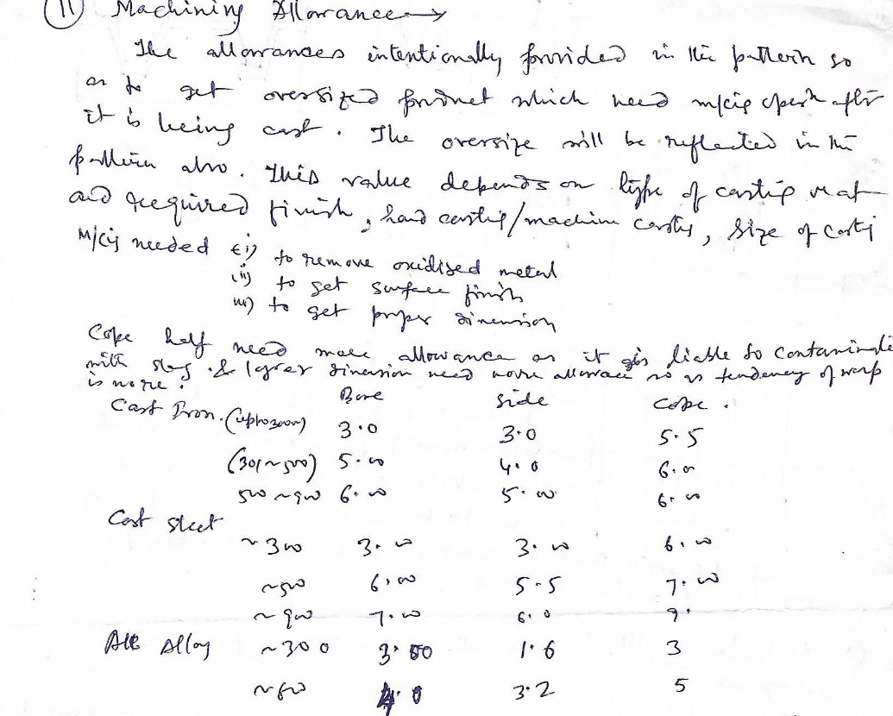

Slide 13
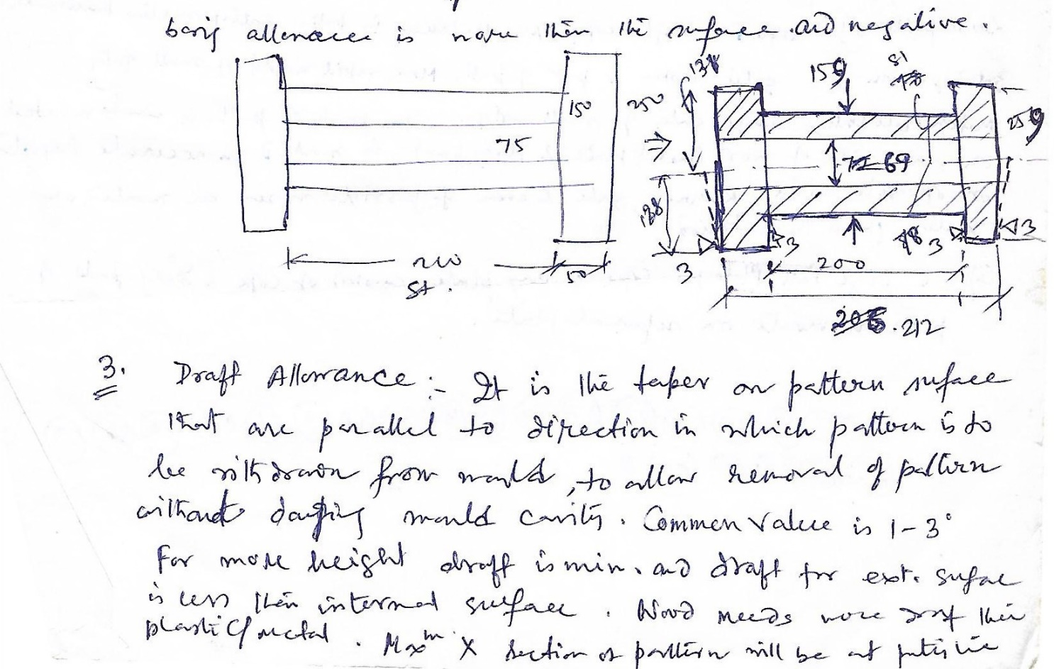
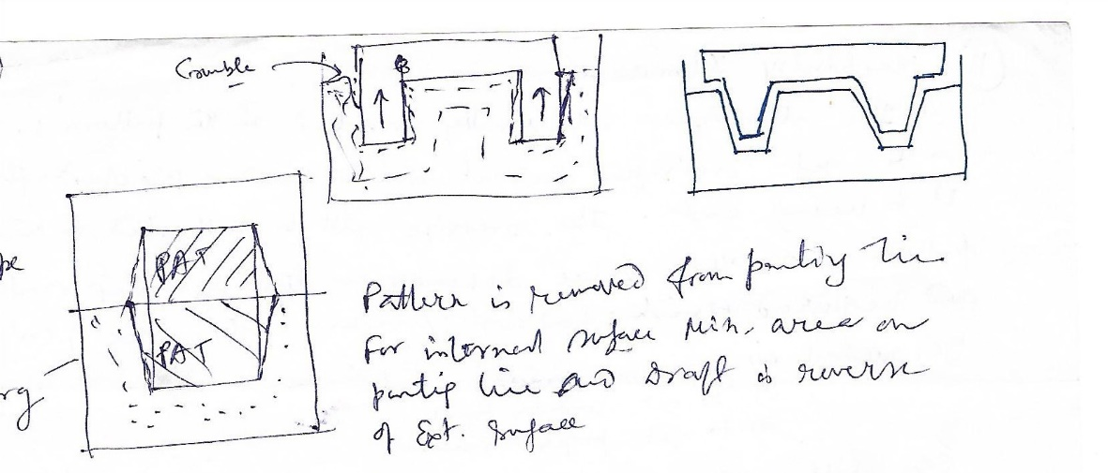

Slide 14
Distortion allowance (camber)
- Vertical edges will be curved or distorted
- This is prevented by shaped pattern converge slightly (inward) so that the casting after distortion will have its sides vertical
- The distortion in casting may occur due to internal stresses. These internal stresses are caused on account of unequal cooling of different sections of the casting and hindered contraction. Prevention:
- providing sufficient machining allowance to cover the distortion affect
- Providing suitable allowance on the pattern, called camber or distortion allowance (inverse reflection)

Slide 15
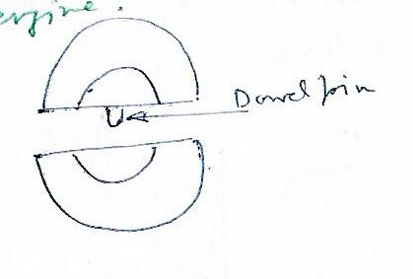
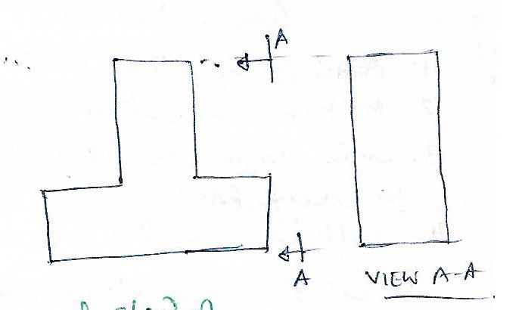
Single piece pattern-
Simplest and inexpensive
For Simple job where withdrawal is not problematic
One surface must be flat acting as parting plane
Pattern is placed on drag
Used for small scale production / development of prototype. Stuffing box and gland of steam engine
Split pattern-
Suitable foe intricate job where withdrawal of pattern is problematic or depth is large
Split surface acts as parting plane
Dowell hole and pin must be provided for alignment
Bearing, pulley, wheekl, spindle, valbe body are manufactured by this.

Slide 16
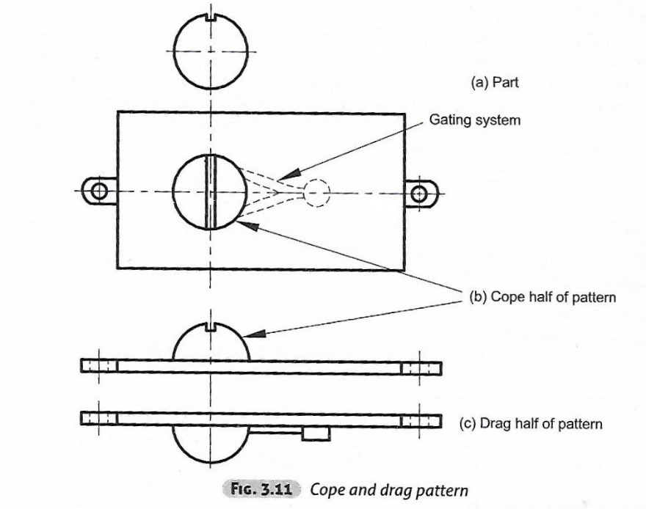
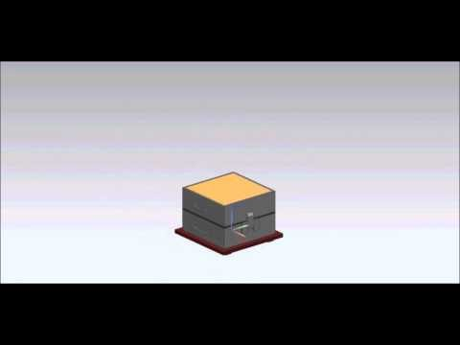
Cope and drag pattern-
Same as split pattern
Gating and risering system alongwith pattern with dowel pins are attached to metal or wooden plate.
used where handling is difficult- as for in case of large casting
Suitable for continuous production.
Match plate pattern-
Single matching metal or wooden plate
One side cope flask other side drag flask
Removal of match plate equipped with gating and risering provide moud cavity
Use for small casting, high accuracy and huge production
Several patterns arte attached to increase production https://www.youtube.com/watch?v=rf8n9J2CDV4

Slide 17
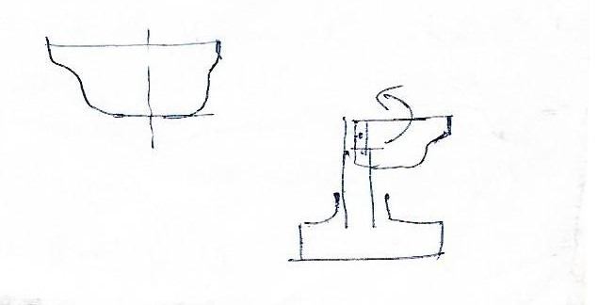
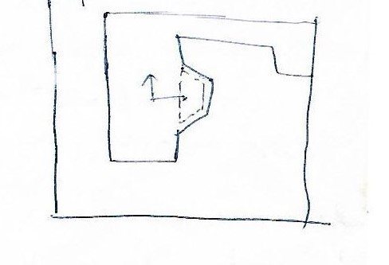
Loose piece pattern-
Contour of part is such that widrawal of pattern is not possible due to projection or backdraft
Obstructing part is held as a loose piece by wire
Same part is removed after removal of main piece
Mostly avoided by suitable design of cast
Highly skilled job and expensive
Sweep pattern-
a section of proper contour is swept w.r.t spindle/axis for development of 3d cavity
Suitable for axi-symmetric bell shaped or cylindrical part
Suitable for large casting

Slide 18
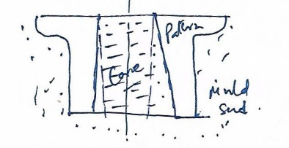
CORE
GREEN SAND CORE-
obtained by pattern itself
low in strength, not suitable for deep hole
sufficient draft is to be provided
Suitable for cavities which facilitate easy withdrawal of pattern
Dry sand core- process involved are
Moulding of green core- split wooden core box are fastened with dowel pin. Core sand is filled and rammed layer by layer and trims off level along top face. Reinforcement material may be added to increase strength and to provide venting.
Baking of core-core obtained by opening core boxes is baked in gas/oil/electric oven to drive off moisture and to harden core. For detail refer corebaking.jpg
batch type- cores placed on tray as batch in oven. One plate taken out for curing while another one placed.
continuous type-core moves slowly thru oven on a conveyor
Finishing-cleaning, brushing(to remove loose sand)
Coating – to coat refractory or protective layer by spraying or dipping, mudding- localized coating wiuth graphite/talc powder for smooth face.
Two or more core may be assembled by using core paste.

Slide 19
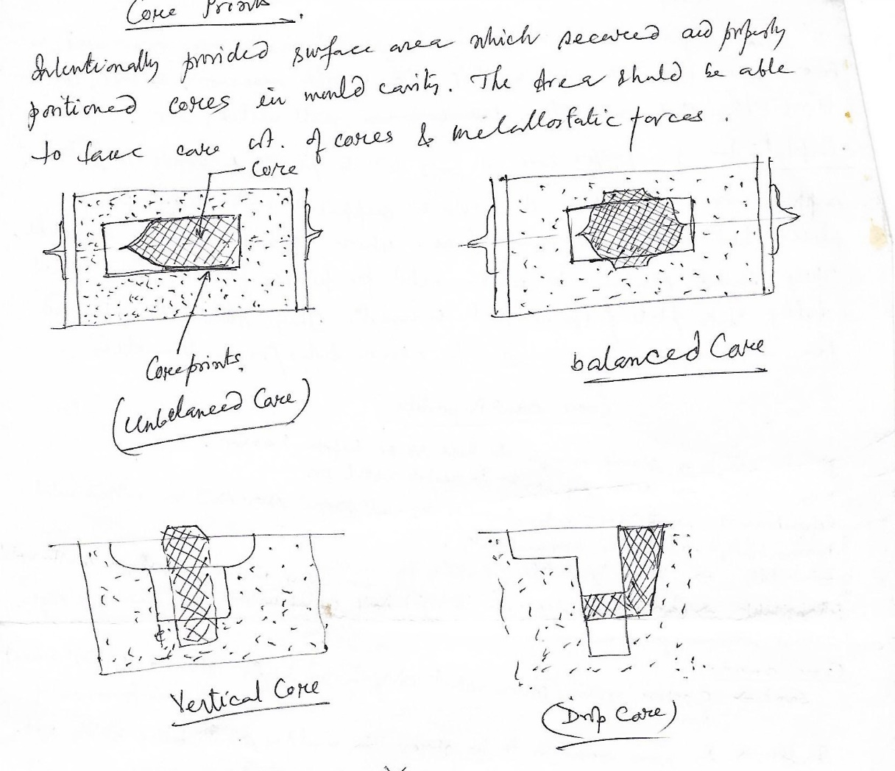

Slide 20
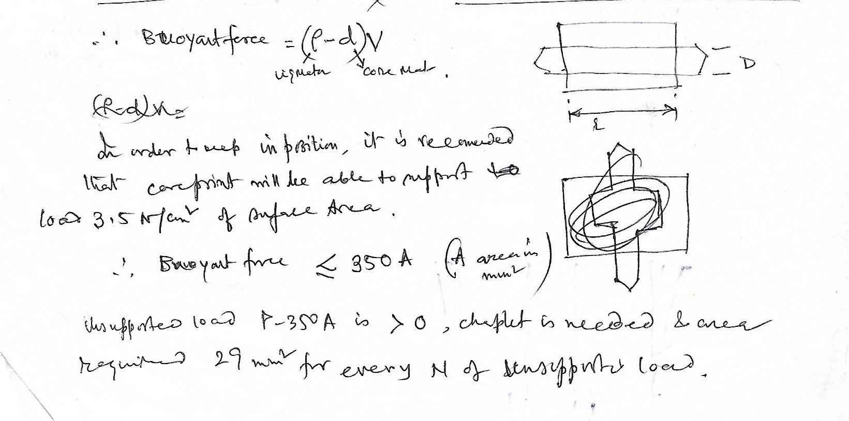
Core calculations

